Slide 1

FISCAL POLICY
What fiscal policy is and why it is an important tool
expansionary fiscal policy and contractionary fiscal policy
multiplier effect and fiscal policy
public debt ~ a cause for concern
implicit liabilities of the government
Fiscal:
Govt Budget = Tax Revenue – Govt Spending – Govt Transfer
= T - G - TR
To First
Active Learning

Slide 2
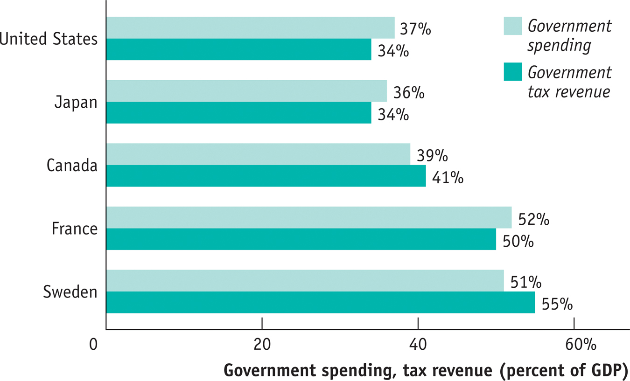
Fiscal Policy: The Basics
Government spending and tax revenue for some high-income countries in 2007 (before the Great Recession, which is a more representative set of data)
Source: OECD.

Slide 3
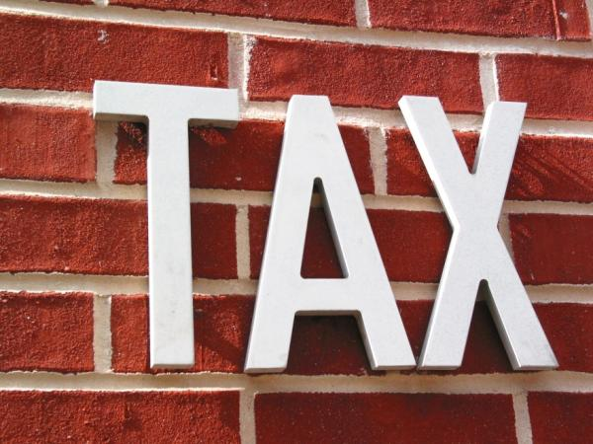
Where the tax revenues go to?
Some important government programs
TR= Transfers
Social insurance programs: government programs intended to protect families against economic hardship.
Social Security
Medicare
Medicaid
CHIP
Unemployment Benefits
Disability Benefits
Food Coupon
Temporary Assistance to Families in Need

Slide 4
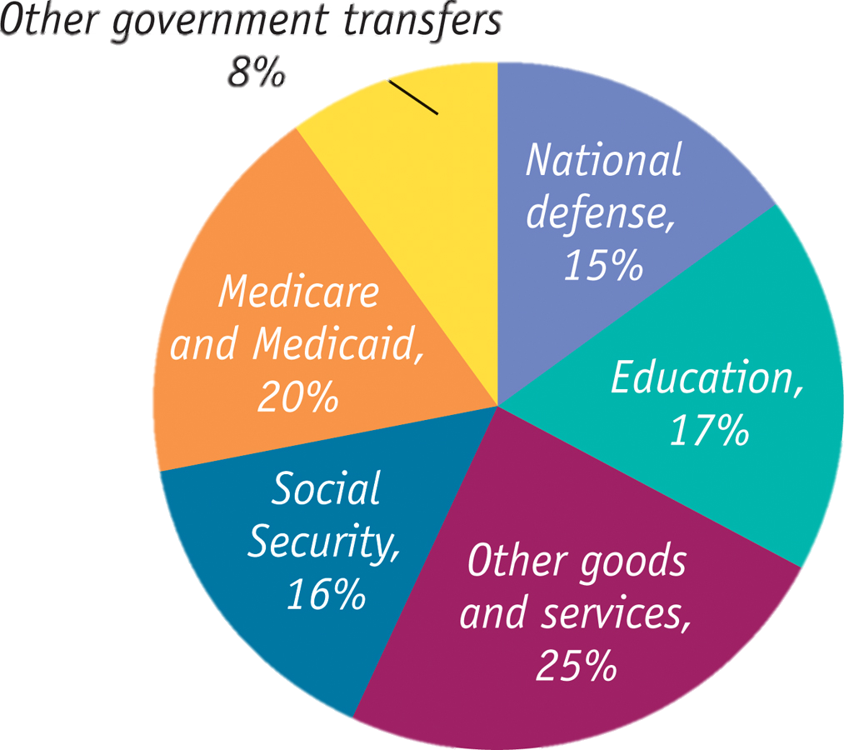
Government Spending in the U.S., 2007
Government purchases(G): National defense and education are the biggest categories.
Government transfers(TR):
Social Security, Medicare and Medicaid are the biggest programs.
Source: Bureau of Economic Analysis

Slide 5
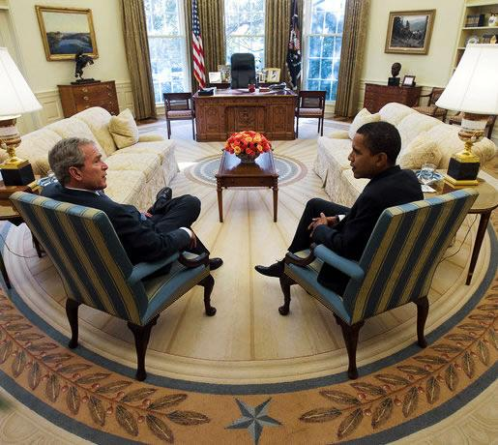
Fiscal Policy: Expansionary or Contractionary
Fiscal policy: the use of taxes, government transfers, or government purchases of goods and services to shift the aggregate demand curve.
I tried a tax cut and tax rebate.
George, I’m gonna go in a different direction.

Slide 6

Fiscal Policy: Through C, I, and G
GDP = C + I + G + X – IM
The government directly controls G and indirectly affects C and I.
C= Consumers Expenditures
I = Business Investments (Firms, Corporations)
How?
C: Household incomes are affected by taxes and transfers (C = Y-T+TR), and
I: business investment is affected by taxes and regulations (I = f (t, i, reg)).
So the government can shift the AD curve by doing Fiscal Policy.

Slide 7

Expansionary Fiscal Policy
Expansionary fiscal policy:
fiscal policy that increases AD (aggregate demand), via:
an increase in government purchases , G
a cut in taxes, T (*including TAX REBATE)
an increase in government transfers, TR
Expansionary fiscal policy:
extra “fuel” for the economy

Slide 8
Expansionary Fiscal Policy Can Close a Recessionary Gap
Aggregate price level
Instead of waiting for the long-run correction mechanism (as in the Classical view), policy makers could choose to stimulate AD and move the economy back toward long-run equilibrium by conducting expansionary fiscal policy.
LRAS
SRAS₁
P₂
E₂
P₁
E₁
AD₂
AD₁
Y₁
Y_{P}
Potential
output
Real GDP
Recessionary gap
Notes:
8

Slide 9

Contractionary Fiscal Policy
Contractionary fiscal policy:
fiscal policy that decreases AD (aggregate demand):
a reduction in government purchases, G
an increase in taxes, T
a reduction in government transfers, TR
Contractionary fiscal policy:
brakes for the economy

Slide 10
Contractionary Fiscal Policy Can Close an Inflationary Gap
Instead of waiting for the long-run correction mechanism, policy makers could choose to contract AD and move the economy back toward the long-run equilibrium.
Aggregate price level
LRAS
SRAS₁
P₁
E₁
P₂
E₂
AD₁
AD₂
Potential
output
Y_{P}
Y₁
Real GDP
Inflationary gap
Notes:
10

Slide 11
Contractionary fiscal policy:
is most helpful for restoring an economy to the potential output level of production when there is a recessionary gap.
shifts the AD curve to the right, restoring the equilibrium level of output to the potential output level for the economy.
often causes inflation or an increase in the aggregate price level.
if effective, shifts AD to the left, resulting in a reduction in the aggregate output and the aggregate price level for a given short-run aggregate supply curve (SRAS).
To Next
Active Learning

Slide 12
Which of the following statements is true? Holding everything else constant:
an economy can eliminate an inflationary gap by increasing government spending.
expansionary fiscal policy refers to an increase in taxes.
when potential output is greater than actual aggregate output, the economy faces an recessionary gap.
when SRAS intersects AD to the right of the long-run aggregate supply (LRAS) curve, the economy faces a recessionary gap.
To Next
Active Learning

Slide 13

A Cautionary Note: Lags in Fiscal Policy
In the case of fiscal policy, there is an important reason for caution: There are significant time lags in its use.
It takes time to:
realize the recessionary or inflationary gap by collecting and analyzing economic data.
develop a plan.
implement the action plan (spending the money).

Slide 14
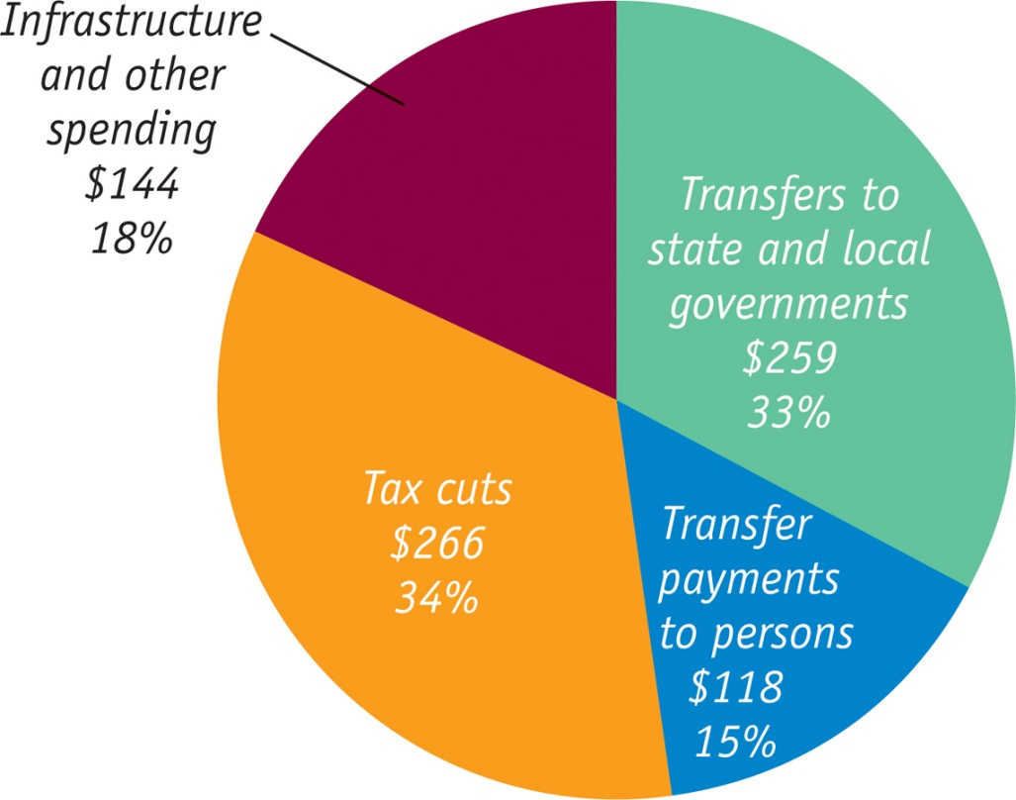
What Was in the Recovery Act?
The American Recovery and Reinvestment Act of 2009 (billions of dollars)
One effect of the recession was a sharp drop in revenues at the state and local levels, which in turn forced these lower levels of government to cut spending. Federal aid was sent to mitigate these cuts.

Slide 15
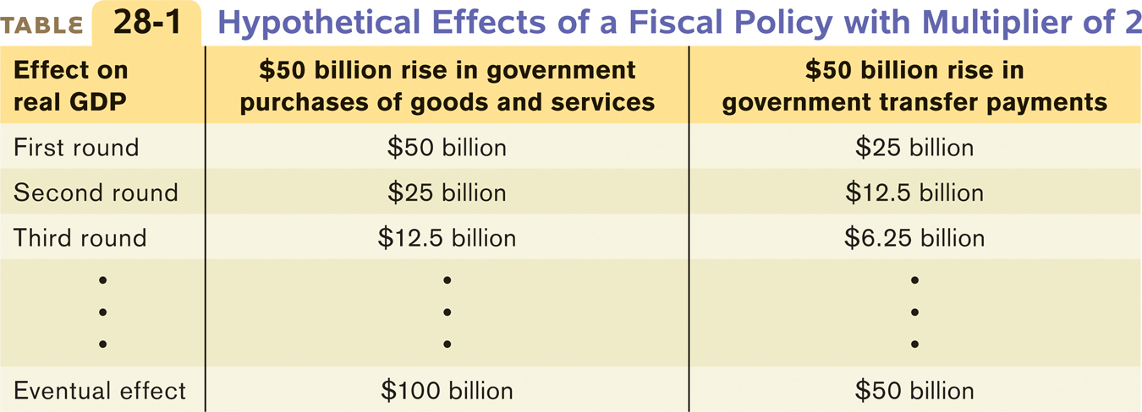
Fiscal Policy and the Multiplier
Multiplier effects of changes in govt transfers and taxes
Will a $50 billion tax cut (or increase in transfers) have the same effect as a $50 billion increase in government purchases?
The size of the shift of the aggregate demand curve depends on the type of fiscal policy (G or T/TR).
G= Govt Expenditures: Infrastructures or purchasing goods/services.
T(=Tax Rebate) and TR : (see example below)
are both part of “income” for the recipients, subject to MPC
Changes in government purchases,G, have a more powerful effect on the economy than equal-sized changes in taxes or transfers.
TR
Y

Slide 16
Multipliers
The first multiplier:
1/(1-MPC) applies to the change in G (as well as the Autonomous C and I)
The second multiplier:
MPC/ (1-MPC) is the multiplier that applies to the change in T or TR
(in lumpsum changes in taxes or transfers).
In our study sometimes we use simple lump-sum taxes: taxes that don’t depend on the taxpayer’s income.
===========================================================================
In Real world, tax is a percentage that depends on the income (from 10% through 39.6%), the multiplier changes to:
The third multiplier:
1/ { 1 – (MPC x (1-t) ) } -- applies to changes in C, I, or G.
The fourth multiplier:
MPC/ { 1 – (MPC x (1-t) ) } --- applies to changes in T or TR.
*) Let’s say the MPC is 0.5 (which is close to 2009 data, at 0.52), applies this MPC=05, into the multipliers, and see how it changes. Let’s say the average tax rate is 20% ( = 0.20).

Slide 17
Examples on Multipliers
Let’s say the MPC is 0.5 (which is close to 2009 data, at 0.52), applies this MPC=05, into the multipliers, and see how it changes. Let’s say the average tax rate is 20% ( = 0.20).
Suppose there is a $200billion output gap due to recessionary gap, and we aim at closing this gap by conducting Expansionary Fiscal Policy. How much to spend for each of the following programs:
Government Expenditures on Infrastructures (G)
Tax Rebates (T)
Government Transfer Program on Families in Need (TR)

Slide 18
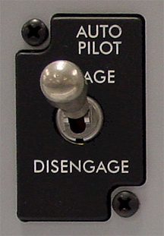
Types of Fiscal Policy
Automatic stabilizers:
As a rule, the government spending and taxation that cause fiscal policy to be automatically expansionary when the economy contracts and automatically contractionary when the economy expands (eg: unemployment insurance).
In contrast, discretionary fiscal policy
arises from deliberate actions by policy makers rather than rules (eg. the Obama stimulus).

Slide 19

Multipliers and the Obama Stimulus
The Obama stimulus was the largest example of discretionary fiscal expansion in U.S. history.
The total stimulus was $787 billion. Did it work?
Two of Obama’s top economists calculated multipliers of 1.57 (spending) and 0.99 (tax cuts).
Imagine, what would Keynes say about this?

Slide 20
Holding everything else constant, the multiplier effect for taxes or transfers ….. compare to the multiplier effect for changes in autonomous aggregate spending:
is the same
is smaller than
is larger than
may be smaller than, larger than, or equal
To Next
Active Learning

Slide 21
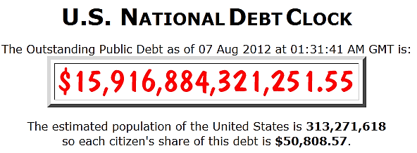
The Budget Balance Measures Fiscal Policy
S_{Government} = T − G − TR
A budget surplus is a positive budget balance, and a budget deficit is a negative budget balance.
Other things equal, expansionary fiscal policies reduce the budget balance for that year.
Other things equal, contractionary fiscal policies increase the budget balance for that year.

Slide 22

War Bond from the World War I
During war times:
the U.S. deficit rises (and so does the debt)

Slide 23

Philosophies on Balancing the Budget
…and lose the ability to help during a recession.
Require an annually balanced budget (austerity)…
Or aggressive fiscal policies during crisis…
…but ends up with budget deficits, and
long-run public debt keep increasing?

Slide 24
Budget Policy in the United States
During 2008 crisis, EU economies: Austerity program; but ends up into deeper crisis.
The United States has its own version of stability pact: The constitutions (of 49 of the 50 states) require a balanced budget every year.
When recession struck in 2008, most states were forced to slash spending and raise taxes in the face of a recession, exactly the wrong thing from a macroeconomic point of view.

Slide 25

The Social Cost of Debt
Greece (the Govt) imposed severe spending cuts to qualify for loans. Greeks (the People) angered by their government’s harsh austerity measures took to the streets in protest.

Slide 26
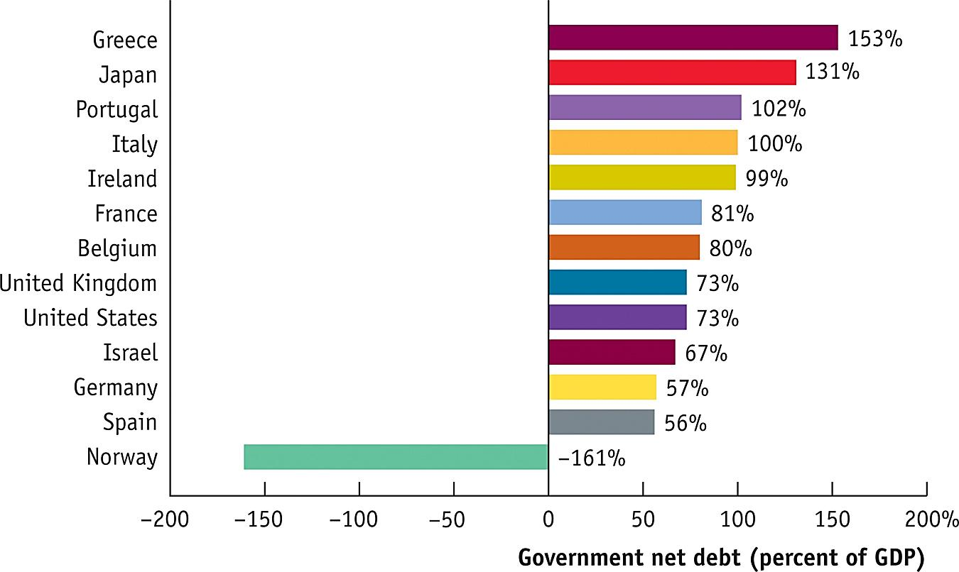
The Comparison of National Debt, 2013
Source: International Monetary Fund

Slide 27
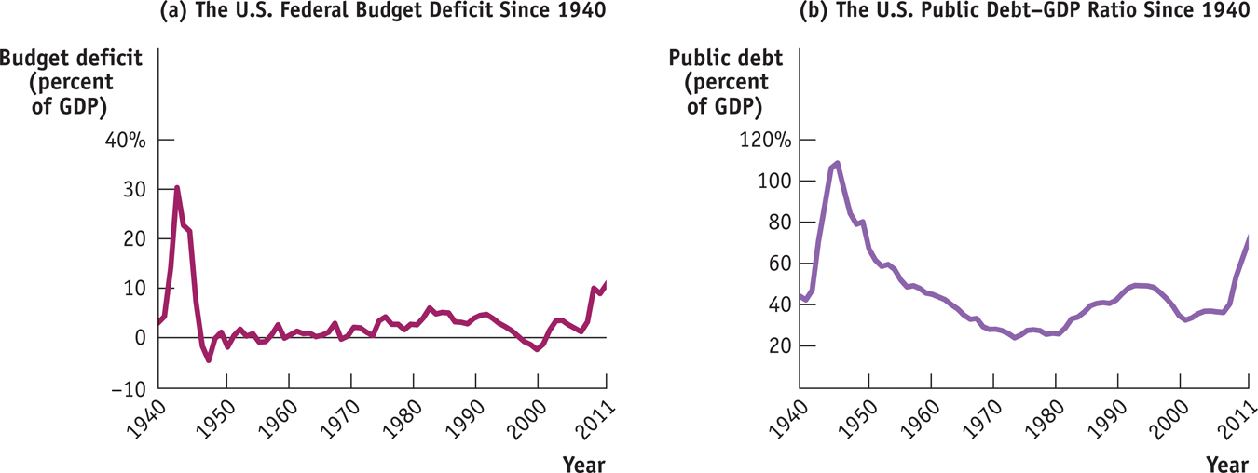
Deficits and Debt in the US
A widely used measure of fiscal health is the debt–GDP ratio.
Source: Office of Management and Budget.

Slide 28
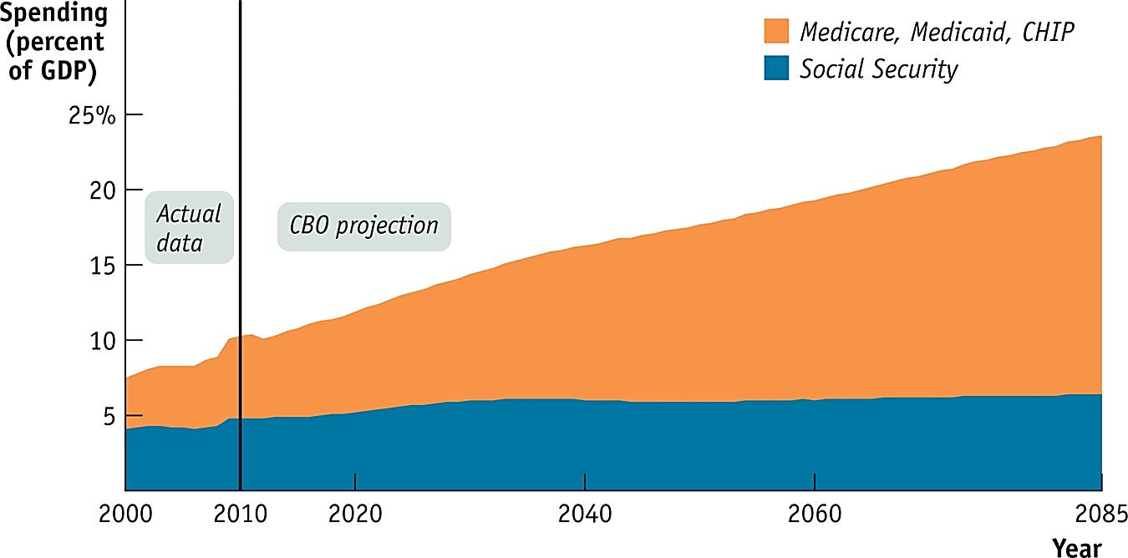
Implicit Liabilities
Implicit liabilities: spending promises made by governments that are effectively a debt despite the fact that they are not included in the usual debt statistics.
Projections: The aging population plus rising health care costs will pose real problems for the federal budget in the future

